Slide 1
Tally With GST
Sachin Sirohi
Tally is an accounting software package used for recording day to day business data of a company

Slide 2
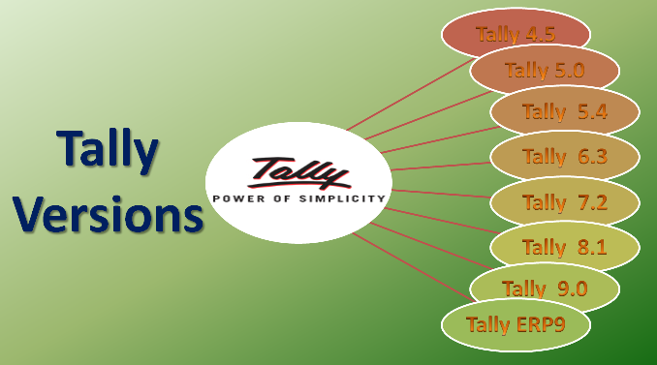
Tally Prime

Slide 3
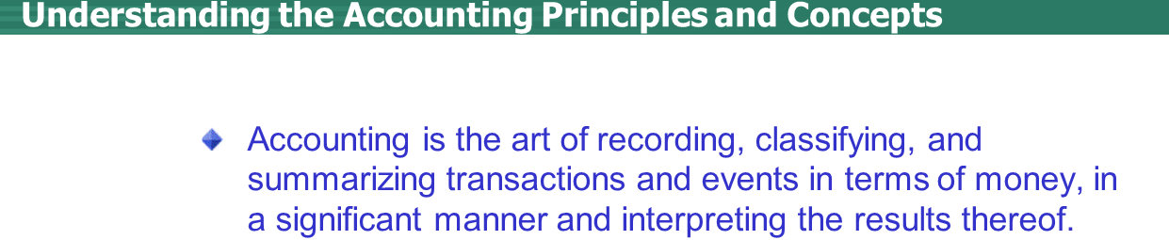
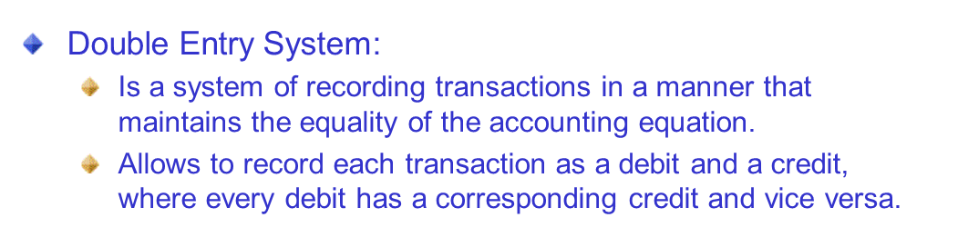

Slide 4
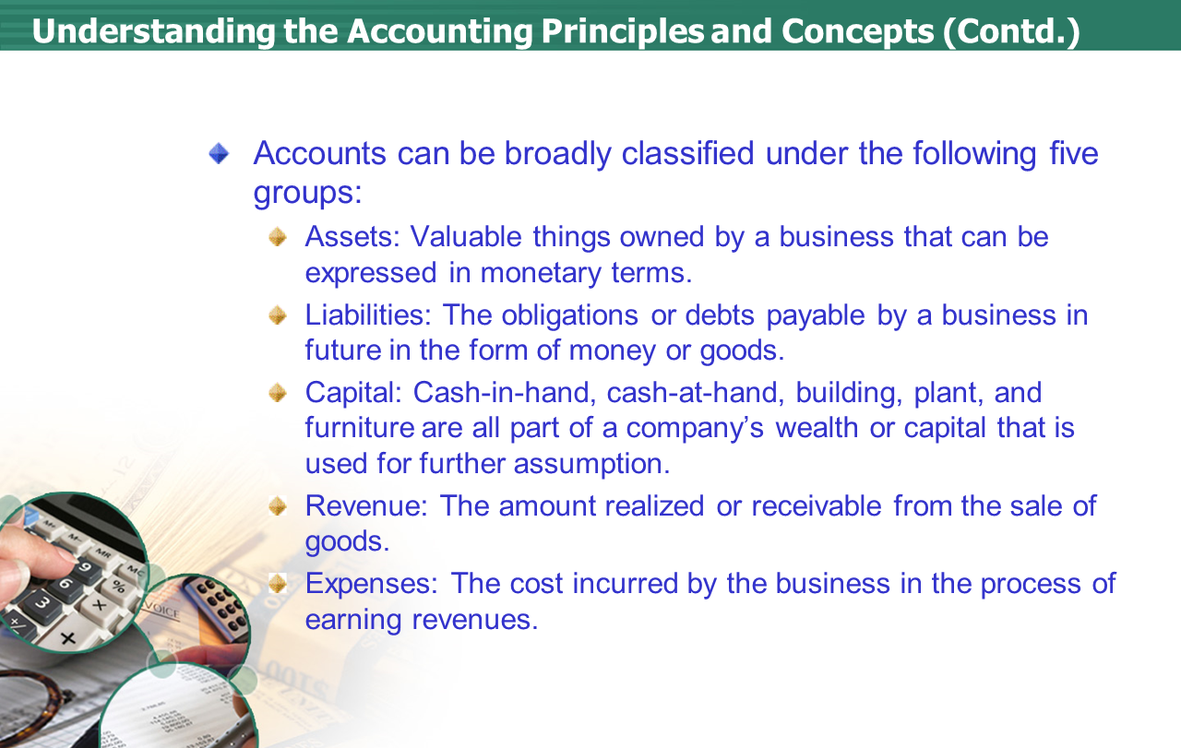

Slide 5
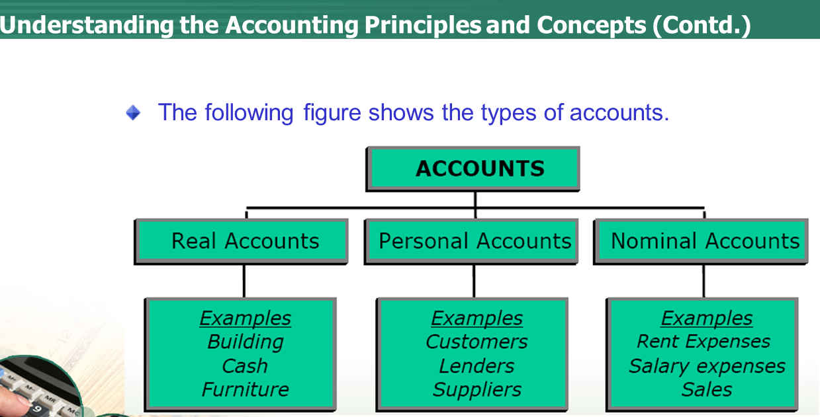
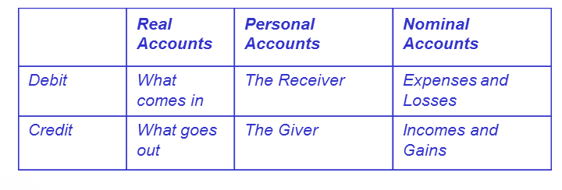

Slide 6
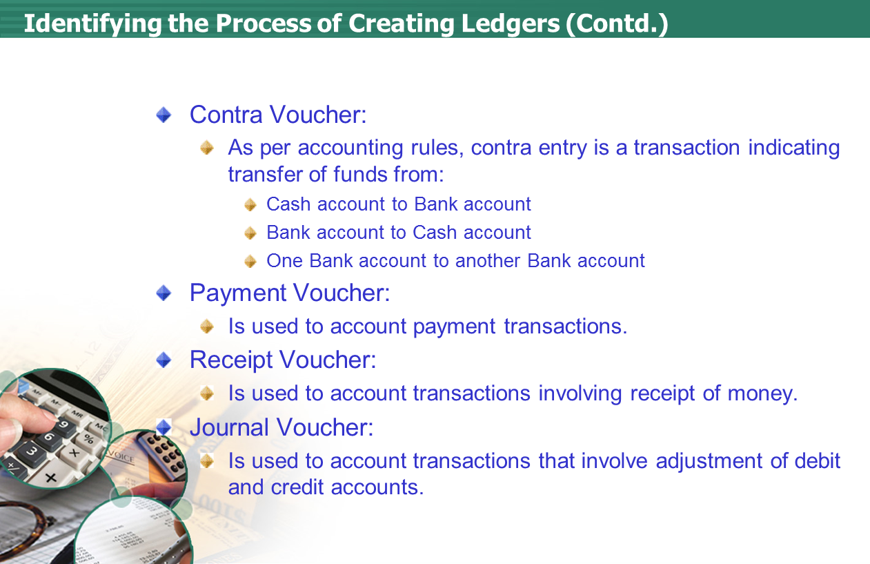

Slide 7
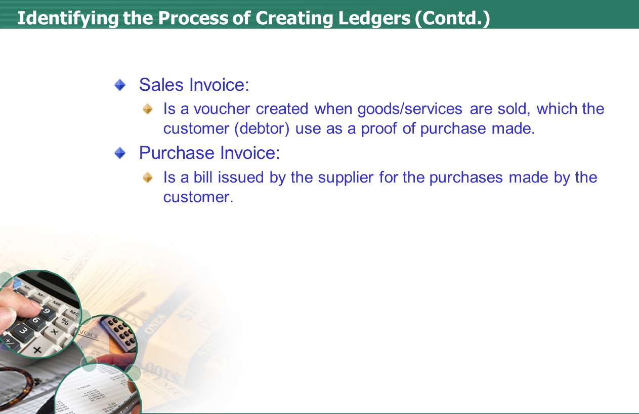

Slide 8
Ledgers
Plant, Building, Machinery etc. - Fixed Asset
Cash - cash-in-hand
Bank- Bank Accounts
Bill Receivable -Current Asset
Libilities - current Liabilites
Loan -Loan(Liabilites)
Bill Payable-Current Liabilites
Security Deposit - Deposit(Asset)
Invest - Investment
Taxes- Duties & Taxes
Debtor- Sundry Debtors
Creditor - Sundry Creditors
Branch -Branch & Division
Purchase - Purchase Account
Sales - Sales Account
Purchase Return- Purchase Account
Sales Return - Sales Account
capital - capital a\c
Drawing - Capital a\c
Expenses - Direct Ex. ,InDirect Ex.
Indirect Expenses- Rent ,Salaryetc
Direct Expenses- Wages, Carriage Inward etc - (Manufacturing & Trading expenses)
InDirect Income- Commison Received, Rent Received etc
Direct Income- Sales of income (non Trade income account that effect Gross Profit means all trade income account )
Suspense - Suspense account
provision - Provisions
stock -stock-in-hand
Reserve - Reserve & Surplus (capital)
Note :- cash and profit & Loss a\c is already created in tally by default.

Slide 9
Vouchers
1. Contra (F4) :- only cash and bank transaction done.
2. Payment (F5):- pay by cash and bank
3. Receipt(F6):- receive amount in cash and bank
4. Journal (F7):- Non cash and bank transaction is allow and credit adjustment
5. Sale(F8):- Sale on cash or credit
6.Sale Return(Credit Note)Ctrl+F8:- to return sale goods reason of defect,
loss etc.
7.Purchase(F9):- Purchase by cash or on credit
8.Purchase Return(Debit Note) Ctrl+F9:- to return purchase goods reason of
defect, loss etc.

Slide 10
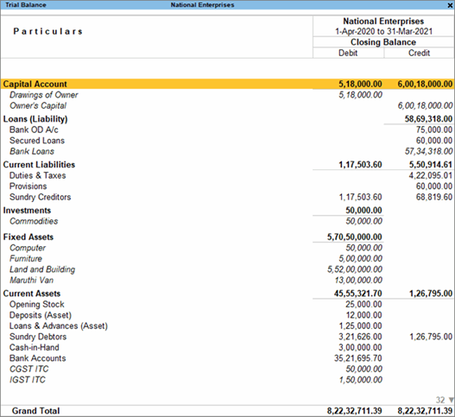
Trial Balance
A trial balance is a financial report of credit entries and debit entries that businesses use to internally audit their double-entry accounting systems.

Slide 11
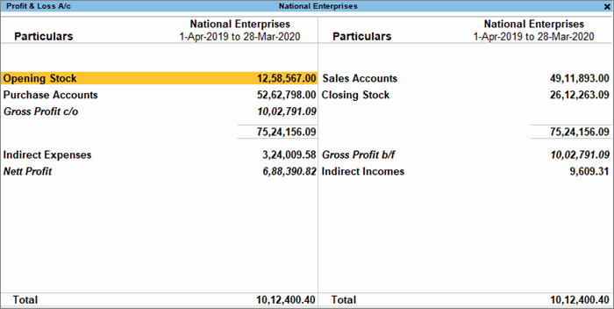
Trading Account
Trading account is used to determine the gross profit or gross loss of a business that results from trading activities.

Slide 12
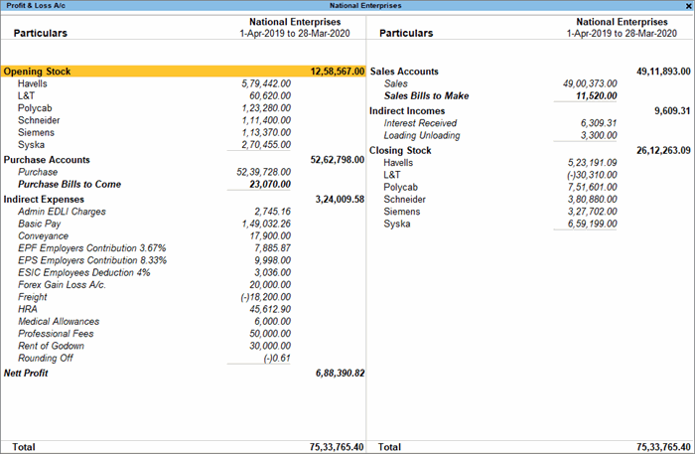
Profit & Loss Account
he profit and loss (P&L) statement is an extremely crucial financial statement that gives a summary of the revenues, costs, and expenses

Slide 13
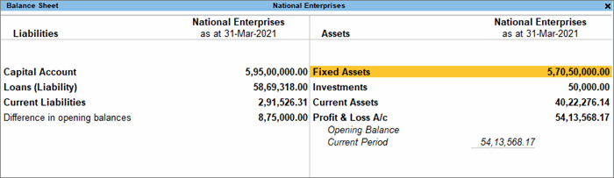
Balance Sheet
A balance sheet is a financial statement that reports a company's financial position. This report shows the balance between the assets and liabilities of a firm

Slide 14
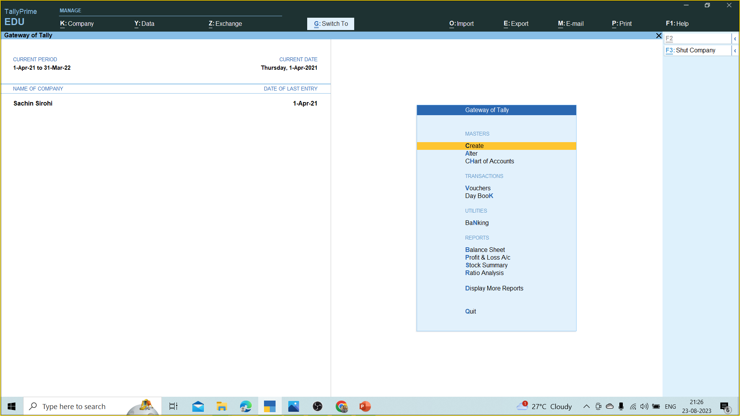
Tally Prime Screen

Slide 15


